Slide 1



5-Stage Pipelined RISC-V Processor on DE1-SoC
Design, Implementation, and Hardware Verification of a 32-bit RV32I Core on Cyclone V FPGA.
Presented by: Afnan Khan
Hira Zahid
Notes:
1

Slide 2

Project Objectives & Scope
The Mission
To architect a fully functional 32-bit RISC-V CPU from the ground up using SystemVerilog, targeting the Terasic DE1-SoC hardware platform.
Architecture
Optimization
RISC-V RV32I Base Integer Instruction Set implementation.
5-Stage pipeline with advanced Hazard Detection and Data Forwarding.
Verification
Real-time Fibonacci sequence visualization via FPGA peripherals.
Notes:
2

Slide 3





The 5-Stage Pipeline Architecture
Pipelining increases instruction throughput by overlapping the execution of multiple instructions.
Fetch (IF)
Retrieves machine code from Instruction Memory.
Decode (ID)
Control Unit decodes OpCodes; Register File read access.
Execute (EX)
ALU computes results and branch targets.
Memory (MEM)
Data RAM access for Load and Store operations.
Writeback (WB)
Updates the Register File with the final result.
Notes:
3

Slide 4


Core Logic: The Control Unit & ALU
The Control Unit
ALU & Barrel Shifter
Acting as the "Brain," it interprets the 7-bit OpCode to generate signals for ALU selection, Register Write Enable, and Branch control.
The "Calculator" handles arithmetic (ADD, SUB) and logical (XOR, OR, AND) ops. We implemented a dedicated Barrel Shifter for high-performance SLL and SRA operations.
Notes:
4

Slide 5

Mitigating Pipeline Hazards
Maintaining data integrity when instructions depend on previous, uncompleted results.
Forwarding Unit
Problem: Read-After-Write (RAW) data conflicts.
Solution: Data is "forwarded" directly from the ALU or Memory stage back to the Execution stage, bypassing the Register File delay.
Hazard Detection Unit
Problem: Load-Use dependencies or Branch mispredictions.
Solution: The unit injects "Bubbles" (Stalls) or flushes the pipeline to ensure the CPU never executes invalid data.
ALU Result
Forward Path
ALU Input
Stall Control
Output from execution stage
Bypass ALU result to input
Receive forwarded operand
Separate signal pauses pipeline
Notes:
5

Slide 6

Hardware Integration: DE1-SoC
Adapting SystemVerilog for the Cyclone V FPGA
To make the processing visible, we implemented a Clock Divider. The 50MHz onboard clock is slowed to ~1.5Hz, allowing the Fibonacci sequence to be tracked by eye.
I/O Mapping:
KEY[0]: System Reset
LEDR: 10-bit Binary Result
HEX0-1: 7-Segment Hex Result
// Clock Divider Snippet
always_ff @(posedge CLOCK_50) begin
count <= count + 1;
end
assign slow_clk = count[24];
Notes:
6

Slide 7
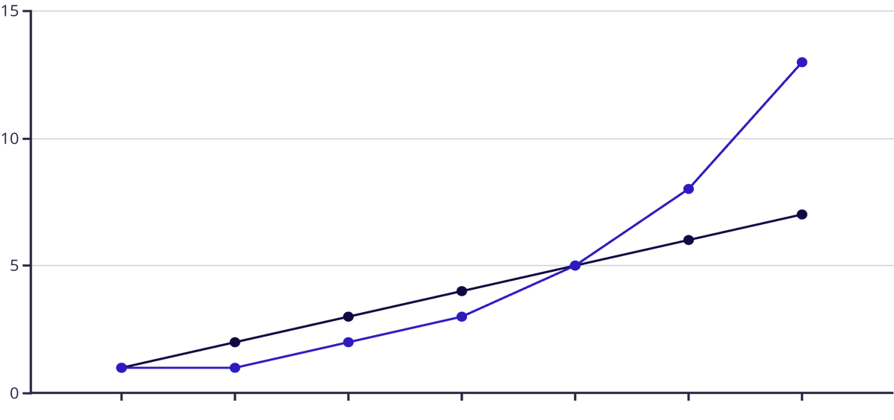
Test Program: Fibonacci Sequence
We used the Fibonacci algorithm to verify the mathematical and branching accuracy of the pipeline.
Assembly Implementation:
addi x1, x0, 0 // Prev
addi x2, x0, 1 // Curr
loop:
add x3, x1, x2 // Next
add x1, x0, x2 // Shift
add x2, x0, x3 // Shift
jal x0, loop // Repeat
Step
Fibonacci Value
Notes:
7

Slide 8

Engineering Challenges & Solutions
01
02
Latch Inference Fix
Hierarchy Resolution
Quartus warned of latches in the Control Unit. We resolved this by defining default values at the start of always_comb blocks to ensure full case coverage.
Fixed "Can't elaborate" errors by purging the Quartus DB folder and ensuring consistent module naming conventions across the project.
03
Pin Assignment Mapping
Dark displays were fixed by manually assigning the Cyclone V Pin IDs (e.g., PIN_AF14) in the Pin Planner to match the DE1-SoC layout.
Notes:
8

Slide 9


Final Hardware Results
<1%
0
Logic Utilization
Critical Errors
Extremely efficient use of FPGA resources.
Clean compilation in Quartus Prime.
Visual Demo: Binary output on Red LEDs and Hexadecimal output on 7-Segment displays confirm sequential correctness.
Notes:
9

Slide 10




Conclusion & Future Work
The 5-stage RISC-V processor successfully demonstrates the power of pipelined architecture on modern FPGA hardware.
Successful Synthesis
Next Step: RAM Support
Next Step: Branch Prediction
Live Hardware Demo
Thank you for your attention.
Notes:
10

